Slide 1
Technical Analysis Indicators

Slide 2
Moving Average

Slide 3
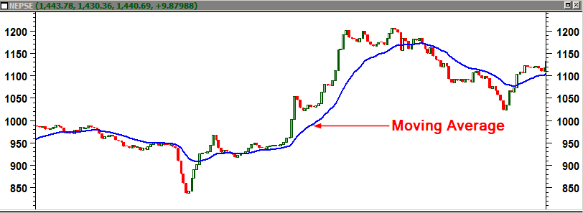
Moving Average
Averaged stock price of specified time period
One of the most successful methods of identifying and profiting from trends
One of the oldest tools used by technical analysts
Moving averages smooth the distorting fluctuations of market
Moving averages can act as a potential support and resistance
Moving averages helps to determine entry/exit zones
Lagging indicator

Slide 4
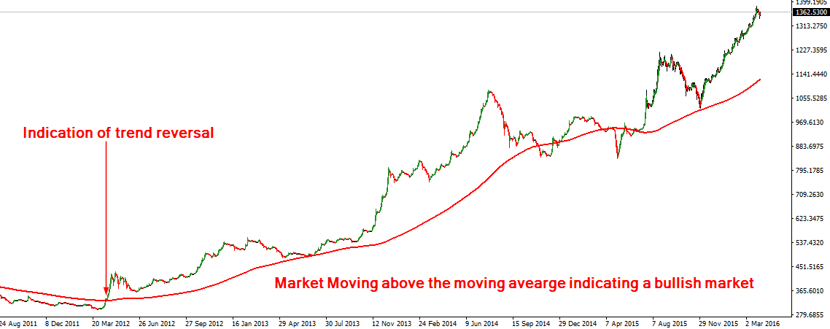
Using Moving Average to Determine Trend

Slide 5
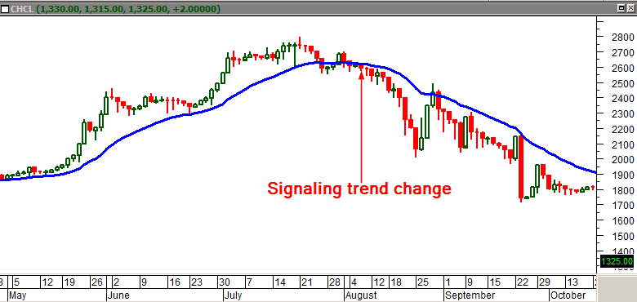
Moving Averages Warn Trend Reversal

Slide 6
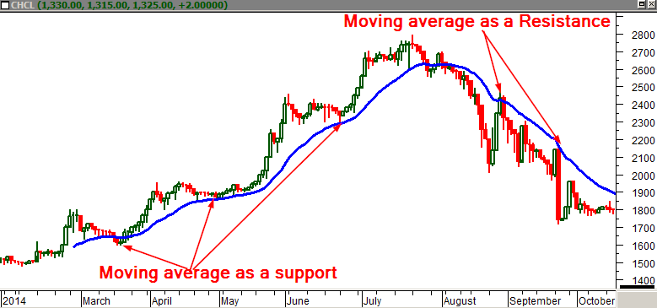
Moving Average as a Support & Resistance

Slide 7
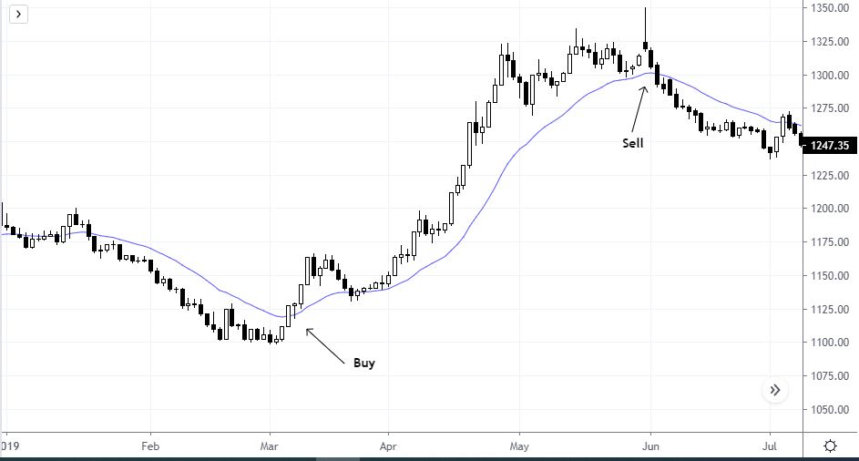
Using Moving Average for Entry/Exit

Slide 8
Length of Moving Average
Length refers to time horizon , popularly called ‘periods ‘
The most popular moving average periods are 10-day, 21-day, 50-day, 100-day, and 200-day
Longer periods give reliable information but they react slow
Faster moving average reacts fast but they tend to give wrong information
It’s best to combine both short and long period moving averages

Slide 9
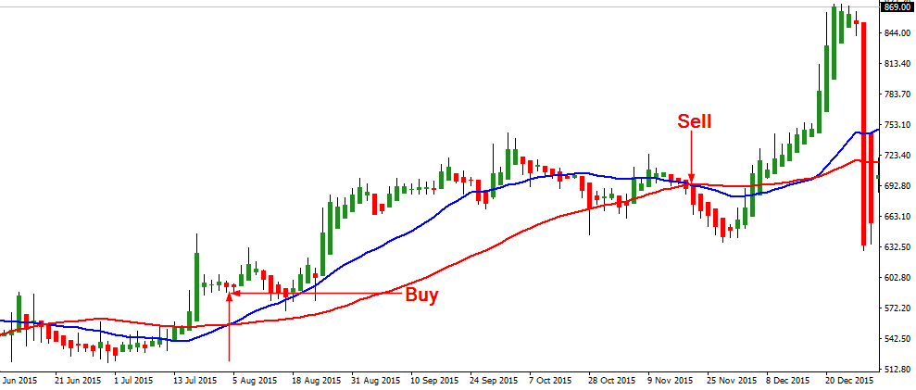
Using Crossovers of MAs to enter/exit market

Slide 10
Simple Moving Average
Example : 5 day SMA
Price : 11,12,13,14,15,16,17
5 SMA(Day 1):11+12+13+14+15 = 65/5 = 13
5 SMA(Day 2): 12+13+14+15+16 = 70/5 = 14
5 SMA(Day 3): 13+14+15+16+17 = 75/5 = 15

Slide 11
Weighted Moving Average
Example : 5 WMA
5+4+3+2+1 = 15
Price : 11,12,13,14,15,16,17
WMA (Day 1) : (11x1)+(12x2)+(13x3)+(14x4)+(15x5)/15 = 13.67
WMA (Day 2) : (12x1)+(13x2)+(14x3)+(15x4)+(16x5)/15 = 14.67

Slide 12
Exponential Moving Average
Example: 5 day EMA
Time = 5 days
Price = 13,14,15,16,17,18 = SMA is 15 (for day 1 EMA)
Multiplier = (2/(time+1))=(2/(5+1))=2/6=.3333
EMA = (close – EMA (previous day)) x multiplier + EMA (previous day)
EMA (Day 1)= 15
EMA (Day 2)= (18-15)x.3333+15 = 15.99

Slide 13
Relative Strength Index (RSI)

Slide 14
Relative Strength Index (RSI)
J. Welles Wilder introduced RSI in June 1978
RSI measures the strength of the trend using past “Gain” and “Loss” data
Formula:
RSI = 100 - 100/(1 + RS*)
*RS = Average Gain/ Average Loss
RSI helps you determine overbought and oversold levels
RSI can range from a low of 0 to a high of 100
A 14-day period RSI is most commonly used

Slide 15
Why to use RSI?
It helps to determine the market direction
It helps to determine overbought/oversold zones
- Overbought : above 70 level
- Oversold : below 30 level
It warns you of possible trend reversals
RSI is Oscillator
Other Oscillator measures center line as zero

Slide 16
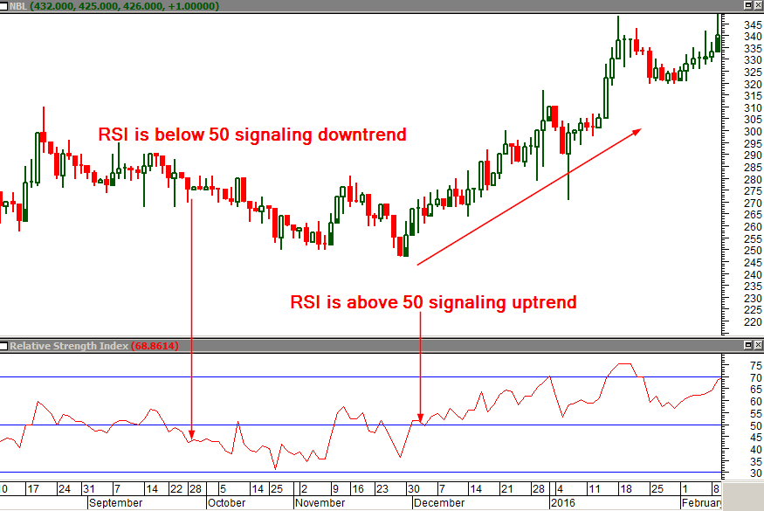
Determining Market Directions Using RSI
Market is assumed to be up when the RSI is above 50
Market is assumed to be down when the RSI is below 50

Slide 17
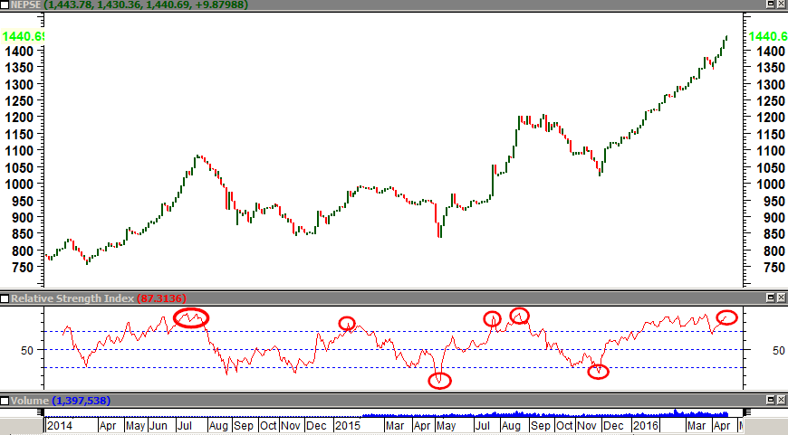
Determining Overbought and Oversold Zones

Slide 18
Determining Reversals Using RSI Divergences
Divergence occur when RSI and Price moves in different directions
There are two types of divergences : 1) Regular 2) Hidden
Divergences help you spot the trend reversals
Divergences can be used as a potential entry/exit zones

Slide 19
Regular Divergence
Bullish regular divergence
Bearish regular divergence

Slide 20
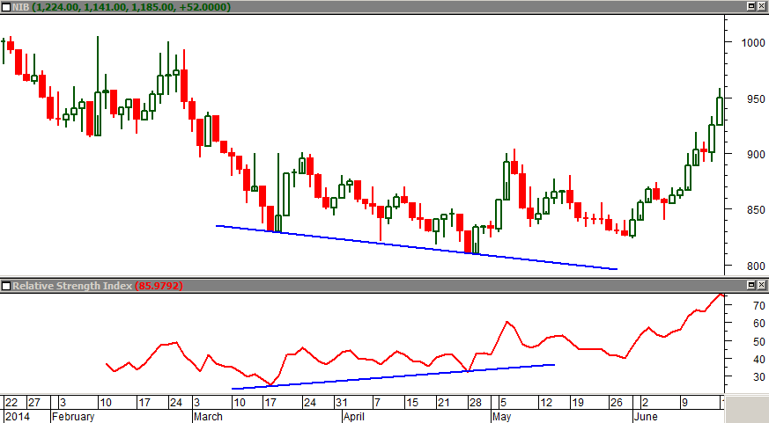
Bullish Regular Divergence
Price forms lower low, RSI forms higher low

Slide 21
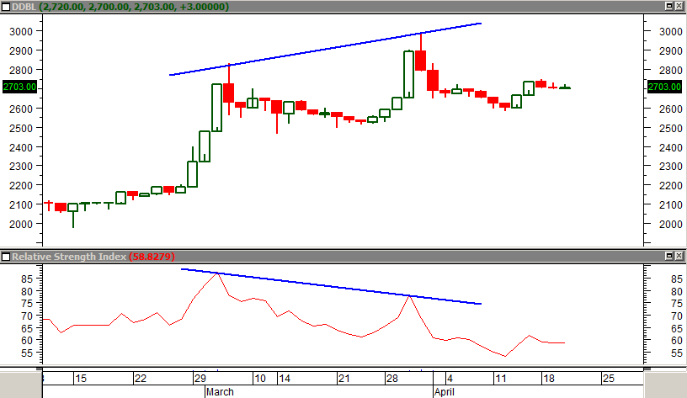
Bearish Regular Divergence

Slide 22
Hidden Divergence
Bullish hidden divergence
Bearish hidden divergence

Slide 23
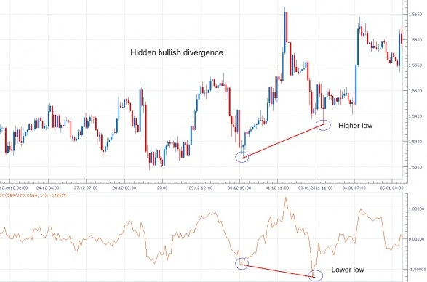
Bullish Hidden Divergence

Slide 24
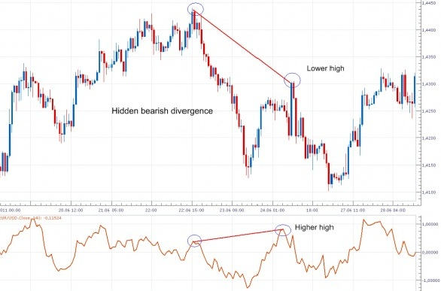
Bearish Hidden Divergence

Slide 25
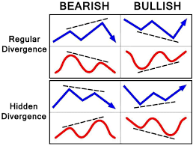
Divergences

Slide 26
There are lots of other Indicators

Slide 27
Thank You

